Slide 1
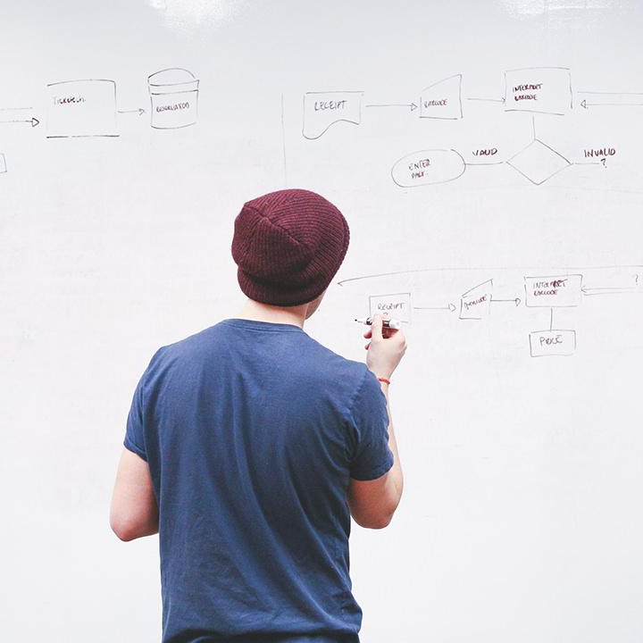
HELLO!
Here 1Crore Projects
I am here because I love to give presentations.
You can find me at @1CROREPROJECTS

Slide 2
Blockchain Based Accounts Payable Platform for Goods Trade

Slide 3

AIM OF PROJECT
The main aim of the project to identify Blockchain Based Accounts Payable Platform for Goods Trade

Slide 4
ABSTRACT
Various business documents like purchase order, dispatch advice, invoices, and receive advice get exchanged among the trade participants during any trade transaction. Similarly, various business processes like freight transport, invoice generation, goods receiving, invoice processing, and payment processing get executed by the participants in a trade transaction

Slide 5
INTRODUCTION
Payment processing involves executing a payment method as per the terms captured in the service contracts between trade participants.
The most common payment method is open account, where the goods is shipped and delivered before the release of funds from the shipper within an agreed time frame.
There is another payment method which involves financing facilitated by banks and financial institutions

Slide 6
EXISTING SYSTEM
In before years the data does not store but here we are using block chain it is more secure for the data
In may transaction area does not send a money in safe mode.

Slide 7
DISADVANTAGES
Lows of security
The user without login, Encrypted data cannot store in block chain

Slide 8
PROPOSED SYSTEM
The impact of increasing transaction send rate on the throughput and latency of compute CA and compute PAs transactions. It was observed that with the increasing transaction send rate, the latency for both the transactions increase.
We conclude that the proposed system easily supports the shipment throughput in the current global trade ecosystem and will scale well even for future workloads

Slide 9
ADVANTAGES
Data was secure
By the different fields create a unique block is used to search a user need.

Slide 10
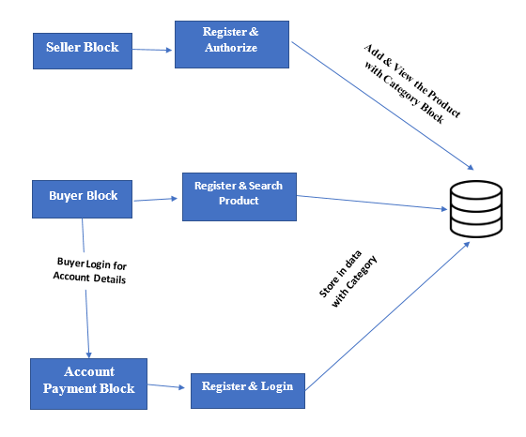
SYSTEM ARCHITECTURE

Slide 11
MODULES
In this project we have 3 module,
1. Seller Block
2. Buyer Block
3. Account payable block

Slide 12
Seller Block
List All Users & Authorize
Add Category
Add Sub - Category
Add mobile Product posts
Add other Products posts
View all Mobile Products
View all Other Products

Slide 13
Seller Block
View Purchased product
Find total Bill on Purchased Products
List All Reviewed on mobile post
List All Reviewed on other post
List all users products searched
View Mobile Rank in chart
View other Product rank in chart
View product search ratio in chart
Logout

Slide 14
Buyer Block
Register and authorize by seller
Login
My Profile
Account Management
Search Mobile Product

Slide 15
Buyer Block
Search Other Product
View My search History
View all product
View Top K Mobile Product
View Top K Other Product
Logout

Slide 16
Account Payable Login
Login
My Profile
View & Process Order
View Purchased Mobile Product by block chain
View Purchased other product by blockchain
Logout

Slide 17
HARDWARE REQUIREMENTS
System | Intel i3 and above
Hard Disk | 40GB
RAM | Minimum 4GB
Processor | 64-bit, four-core, 2.5 GHz minimum per core

Slide 18
SOFTWARE REQUIREMENTS
Front End Language | HTML, CSS, JAVA, JSP SERVELTS
Backend | My SQL
Operating System | Windows 10 or 11
IDE | JAVADEVELIPEMENKIT

Slide 19
FUTURE WORK
In Future show that its practical to deploy one such system in real-world customer environments. We are currently experimenting with the use of the proposed system in collaboration with the participants of the Trade Lens platform.

Slide 20
CONCLUSION
We discussed the need for a block chain based accounts payable system that eliminates the process redundancies (accounts payable vs. accounts receivable), enables efficient invoice processing, and reduces the amount of time spent in reconciling disputes between the transacting participants in goods trade (domestic and global)

Slide 21
REFERENCE
[1]S. E. Chang, H. L. Luo, and Y. Chen, “Blockchain-enabled trade finance innovation: A potential paradigm shift on using letter of credit,” Sustainability, vol. 12, no. 1, p. 188, 2020.
[2] J. Chiu and T. V. Koeppl, “Blockchain-based settlement for asset trading,” The Review of Financial Studies, vol. 32, no. 5, pp. 1716– 1753, 2019.
[3] A. Bogucharskov, I. Pokamestov, K. Adamova, and Z. N. Tropina, “Adoption of blockchain technology in trade finance process,” Journal of Reviews on Global Economics, vol. 7, pp. 510–515, 2018.

Slide 22
THANKS!
Any questions?
You can find me at
Reach us – 1croreprojects@gmail.com
Contact / Whatsapp: 7708 150 152 / 9751 800 789 / 790 432 0834

